Slide 1
Psychological Response to Injury
Lesson 6

Slide 2
Intro
If you have ever been injured, how did you MENTALLY react?
  Were you Sad, Angry, Upset?
Did your feelings change as you progressed through the injury?
  Did you start to accept it? Work hard to return?

Slide 3
Objectives
1. Identify individual reaction to injury.
2. List individual response to injury.
3. Recognize individual response to injury.

Slide 4

Terminology
Psychological: Relating to the mind.

Slide 5
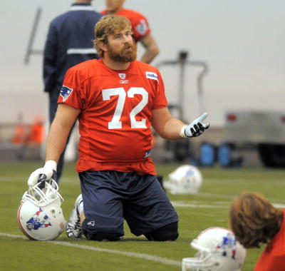




Mind’s reaction to Injury
Psychological Stages
*In Alphabetical Order*
  Acceptance
  Alienation
  Anger
  Bargaining
  Denial
  Depression

Slide 6
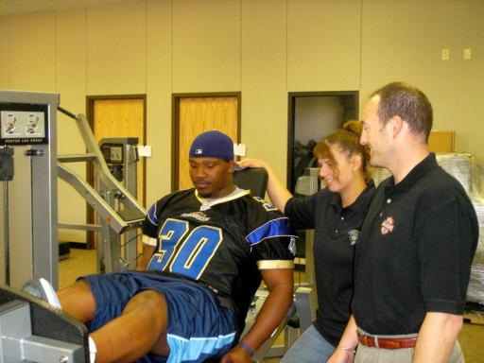
Let’s define them!
Acceptance
  The injured athletes’ willingness to deal with the injury and the limitations imposed by it.

Slide 7
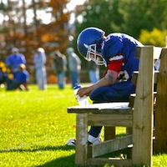
Terminology Cont…
Alienation
  Separation or isolation from your teammates, friends, & support system
  Feeling the need to “handle things on your own”

Slide 8
Terminology cont…
Anger
  The athlete’s emotion of being sad or upset that the injury occurred

Slide 9
Terminology cont…
Bargaining
  Athlete attempting to persuade those in charge that he/she can safely participate in some activity
  Even though they are unable to do so!!

Slide 10
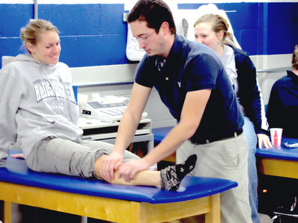
Terminology Cont…
Denial
  Inability to accept the injury as having occurred and accepting limitations imposed by the injury.
  Desire or feeling that injured body part doesn’t belong to the athlete’s body.

Slide 11
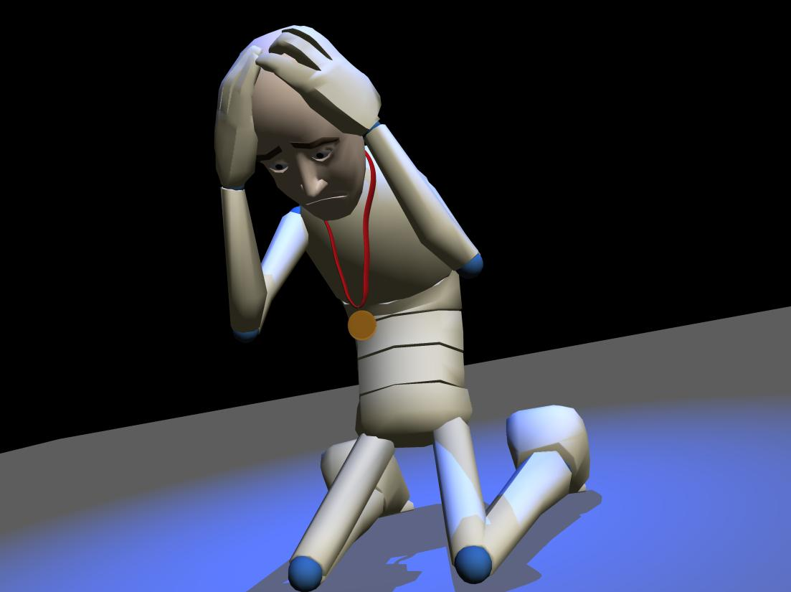
Terminology Cont…
Depression
  The emotional state of being overwhelmingly sad about a situation or circumstance.

Slide 12
Ordering
There is a certain order that these physiological behaviors follow
What order would you put them in?
You have 2 min to work with a partner.

Slide 13
Identify the behavior
“I’ll be alright, it doesn’t hurt that bad. I think I’ll be able to play next week.”
Denial

Slide 14
Identify the behavior
“Leave me alone, I’m fine on my own!”
Alienation
Why?

Slide 15
Identify the behavior
“This is OUTRAGEOUS! I don’t need this injury now. Playoffs are in two weeks!”
Anger

Slide 16
Identify the behavior
“Can I just play this next game. It’s against our rivals. I promise I’ll do rehab 3 times a day for the next month!”
Bargaining

Slide 17
Identify the behavior
Why should I come in to the training room for therapy and rehab? What’s the use? My season is over, anyway!”
Depression

Slide 18
Identify the behavior
I’m willing to do whatever it takes to help my injury heal.”
Acceptance

Slide 19
Exit Card
On a small sheet of paper:
  Write what “psychological injury” means to you.
  List the stages of psychological behavior IN ORDER.

